Slide 1
Jarvis Home Assistant
Team Protégé
Anish Chopra, Jason Milasincic, John Weber, Gregory Desrosiers

Slide 2
Jarvis Home Assistant
Idea
Complete and Integrated Home Automation
Eliminate repetitive and sequential tasks
Utilizing and extending the Google Home Mini
Have someone ‘at-home’ even when you’re not
Current Progression and Goals
Messenger Interface now working
Established partnership with Google
To add the Google Home interface
To incorporate new features, i.e. setting timers to devices.

Slide 3
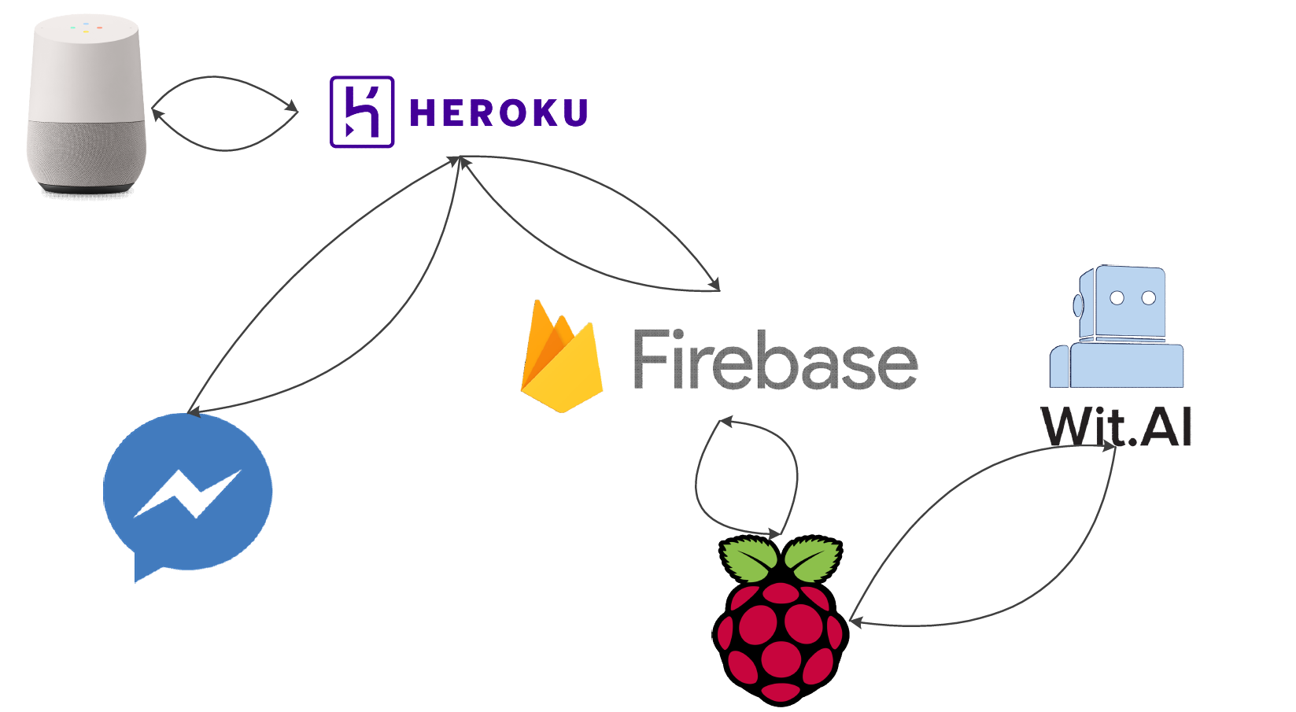
Workflow

Slide 4
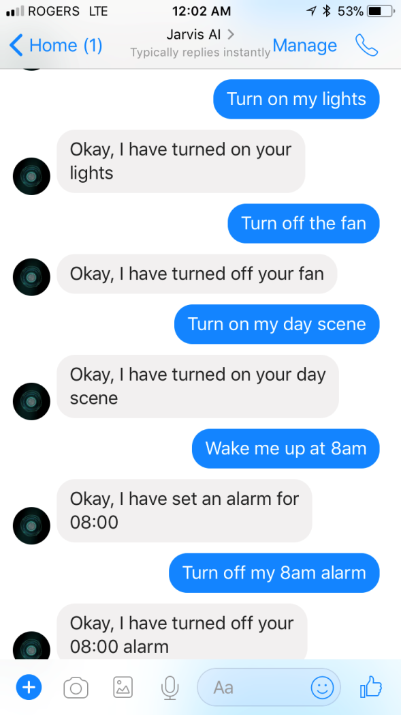
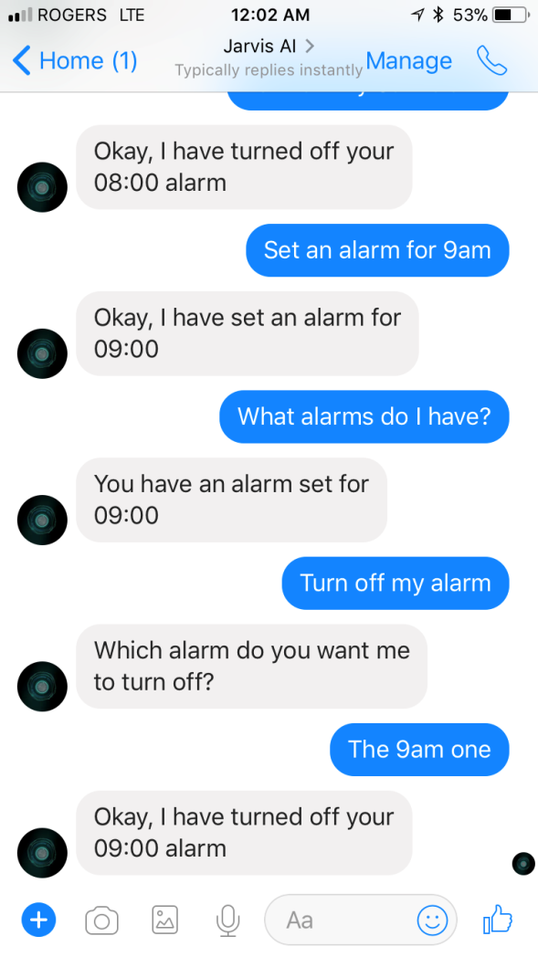
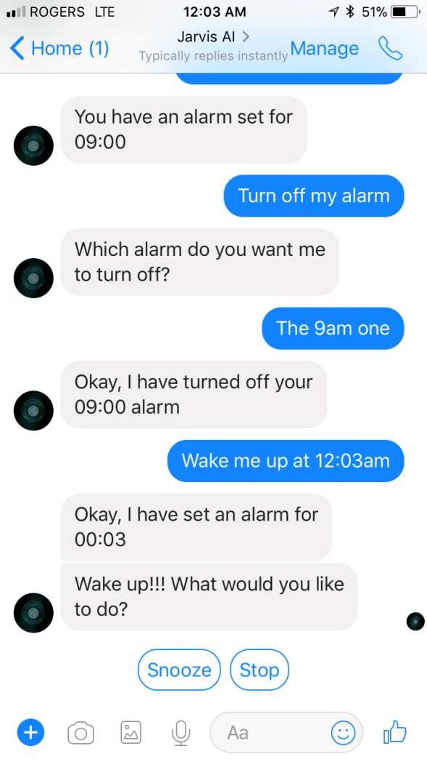
Facebook Messenger Integration

Slide 5
Challenges
Dealing with the Messenger and Google Assistant interfaces for specific actions
Taking advantage of specific features from each, Eg. Quick reply menu options on Messenger
Understanding and utilizing the Google Assistant SDK
Integrating ‘things’ into Jarvis
No standard API

